Slide 1
Loanwords and sentiment
Tim Döring
Daniel Mol
Victor Gordan

Slide 2
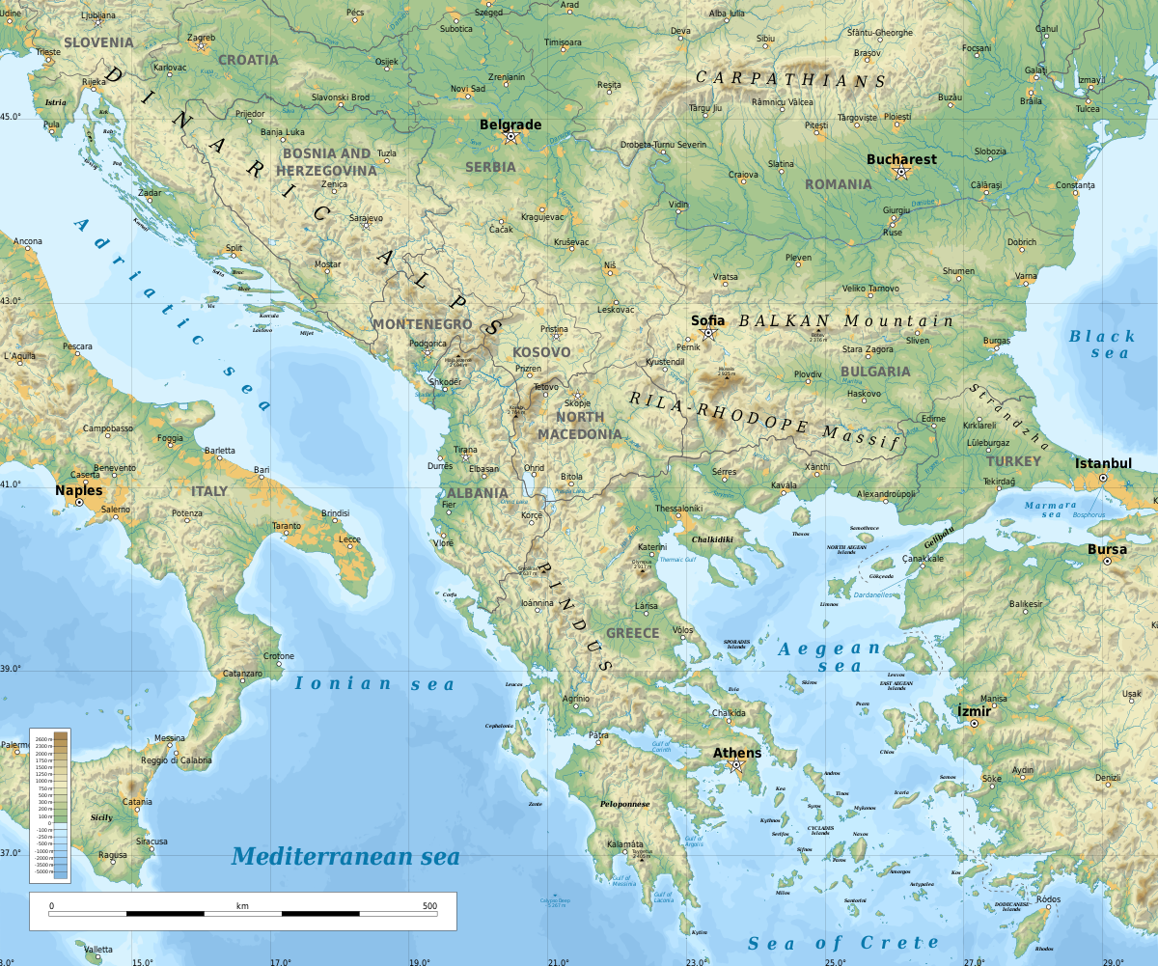
The initial idea
Romanian loanwords:
‘a iubi’ from Old Slavonic (ljubiti)
‘dușman’ from Ottoman-Turkish (دشمن)
Is the sentiment of loanwords related to history?
Source: External history of the Romance languages by Robert A. Hall Jr.

Slide 3
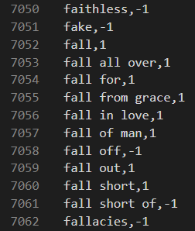
Sentiment data
Easy to find
Compiled three data sets
Mixed quality
Translated

Slide 4
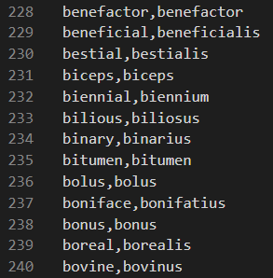
Loanwords origin
Hard to find
Only from EZGlot
Only modern*
Limited in nr.
*with the exception of Latin

Slide 5
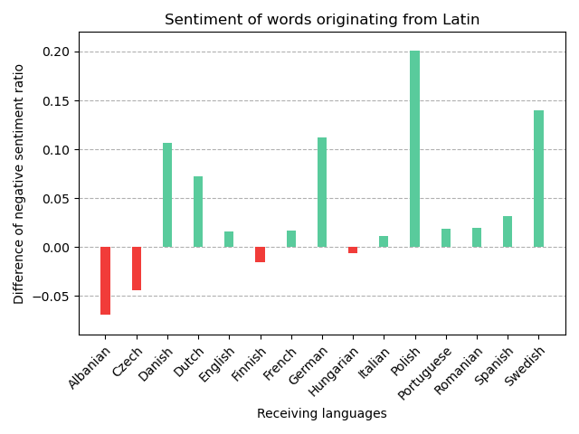
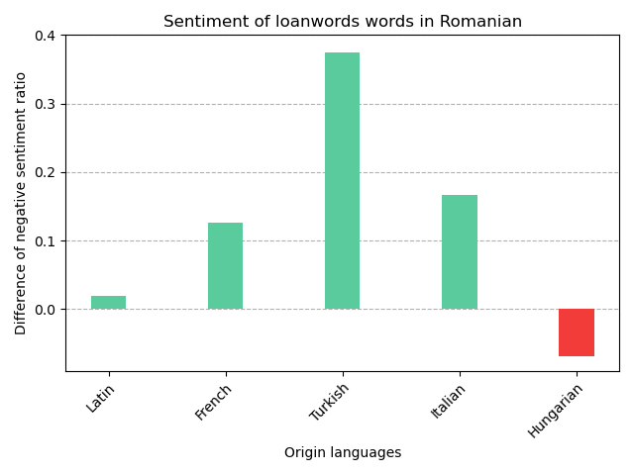
Example of Results
Sentiment dataset negative ratio is 55%

Slide 6
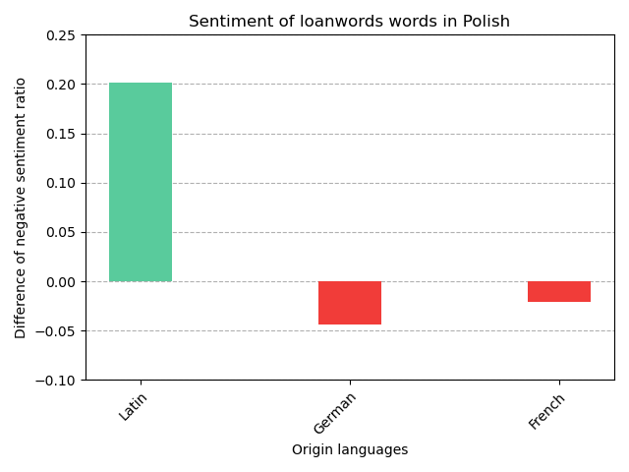
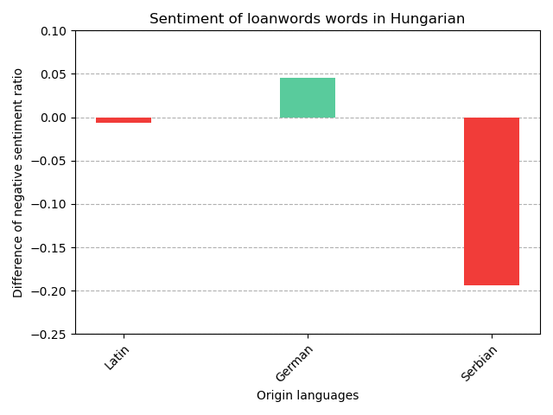
Findings
Predicted positive/negative
63% correct predictions
2% chance (stat. significant)
Suggests there is a correlation

Slide 7
Context analysis - Tweets in English
Main Datasets: - 1.6 Million Tweets - English loanwords from Dutch, French, German, Latin, Portuguese
Results | Dutch | French | German | Latin | Portuguese
vs - | 57.47% | 54.33% | 34.89% | 43.19% | 55.41%
dominant | 0.24% | 7.93% | 0.16% | 47.42% | 0.06%
total | ~ 7 K | ~ 218 K | ~ 4.5 K | ~ 1.2 M | ~ 2 K

Slide 8
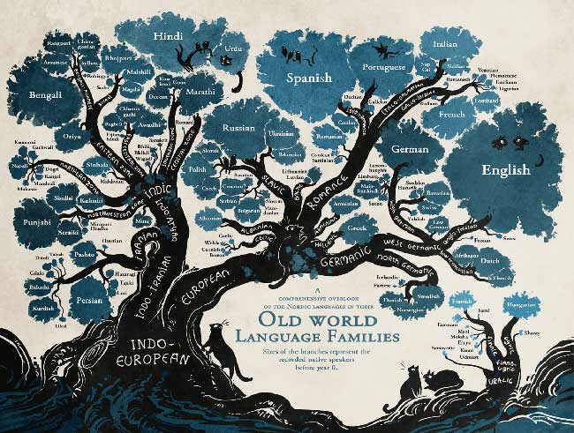
Problems
Limited origin data on some languages
Only one ancient language
Country relations somewhat subjective
Mixed quality sentiment dataset

Slide 9
Relation to course
Text Mining for humanities research
Web scraping
Dataset processing
Sentiment analysis

Slide 10

Next steps
Wikipedia vs Wiktionary for origin of words
Country relations less subjective
Incorporate feedback

Slide 11
Thank you!

